Slide 1


Department of Artificial Intelligence and Data Science
Flight Delays Prediction
Dr.P.Indira Priya,Prof
Giridharan R (231801040) Goutham Raj k(231801044) AI&DS-’A’

Slide 2
Problem Statement
Develop a predictive system to accurately forecast flight delays using various data sources, aiding airlines, airports, and passengers in minimizing the impact of delays.​

Slide 3
Objectives
To predict flight delays and estimate their duration using historical flight data, weather information, and other relevant factors, to support proactive decision-making and improve operational efficiency for airlines and airports.

Slide 4
Abstract
This project aims to predict flight delays and estimate their duration using historical flight data, weather conditions, and other relevant factors. ​
By developing predictive models, the project supports proactive decision-making for airlines and airports, helping to improve scheduling, resource allocation, and passenger experience.

Slide 5
Introduction
Flight delays are a common issue that affects passengers, airlines, and airport operations. ​
By providing early predictions, the project seeks to support better planning, enhance operational efficiency, and improve overall travel experience for passengers.

Slide 6
Overview of the Project
Use advanced machine learning models to analyze data from multiple sources, such as weather, flight schedules, and historical delays, for accurate delay predictions.
Allow airlines and airports to proactively manage delays, optimizing schedules and resources to reduce the operational impact.
Empower passengers with real-time updates, helping them plan better and reduce travel disruptions.
Provide actionable insights to stakeholders, enabling informed decision-making to improve overall efficiency and service quality.

Slide 7
Existing System
The existing systems for predicting the likelihood of E-Signing completion in loan processing typically rely on traditional methods such as rule-based systems, manual intervention, and basic data analysis, but their predictive capabilities are limited in terms of accuracy and automation.
The overview of some of the common approaches used these days are:
1. Rule-Based System: decision-making framework that uses a set of predefined rules or criteria.
2. Basic Data Analytics:Basic analytics tools are used to analyze historical data to understand applicant behavior and detect patterns related to E-Signing completion

Slide 8
Drawback of Existing System
Limited Data Sources: Many current systems rely on limited data (e.g., only historical flight data or basic weather info), leading to less accurate predictions.
Inconsistent Accuracy: Due to outdated or simplistic models, existing systems may not account for complex factors (like real-time weather changes or air traffic control issues), resulting in inconsistent or inaccurate forecasts.
Lack of Real-Time Updates: Many systems lack real-time prediction updates, which can leave passengers and airlines unaware of potential delays until it’s too late to make adjustments.

Slide 9
Proposed System
Real-Time Updates and Notifications: The system continuously monitors real-time conditions and updates predictions accordingly, allowing airlines, airports, and passengers to receive timely alerts and adjust their plans.
Comprehensive Data Integration: The system combines multiple data sources, including historical flight data, real-time weather updates, air traffic information, and airport congestion levels, to improve prediction accuracy.

Slide 10
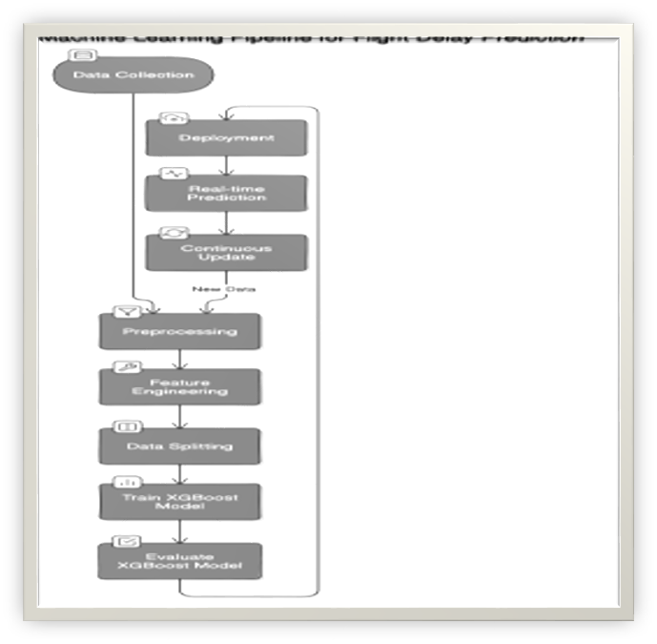
System Architecture
1. Gather and prepare data for training by cleaning and transforming it into a usable format. 2. Train a predictive model on historical data to classify applicants based on their likelihood of E-Signing. Evaluate the model using metrics like precision-recall.
3. Deploy the model and Use it for real-time or batch predictions, generating scores for each applicant's E-Signing likelihood.
4. Continuously monitor model performance and update with new data to improve accuracy, ensuring the model adapts to evolving customer behaviors.

Slide 11
Modules
This project aims to predict the likelihood of applicants completing the E-Signing step in the loan process through a series of modules. These include Data Collection and Preprocessing, Feature Engineering, Model Development and Training, Model Evaluation, Deployment and Prediction, and Monitoring and Feedback.
Each module plays a vital role in gathering, analyzing, and using data to improve loan conversion rates and enhance customer experience, creating an efficient end-to-end solution for loan processing and engagement.
There are 2 modules involved in the proposed system
1. Data Collection and Preprocessing
2. Model Development, Training and Evaluation

Slide 12
Module 1-Data Collection And Preprocessing
We collect the data through the csv file (P39-Financial-Data.csv)
We now preprocess data by 1. Removing the unnecessary columns by dropping the columns 2.Check for missing values and handle them by simply filling it with NaNs with mean. 3.Now we plot the heatmap and select the most relevant features for further processes.
Separate features(X) and target(Y).
Now, Check if the target is being continuous and binarize it if necessary .
Finally, Scale the features, ensuring that no single feature dominates the learning process

Slide 13
Module 2-Model Development, Training and Evaluation
After all the stages of preprocessing is done.
Model training : # Instantiate the XGBoost Classifier xgb_clf = XGBClassifier(random_state=0, n_estimators=100, objective="binary:logistic", learning_rate=0.1) # Parameter Explanations
1. random_state=0: Ensures reproducibility
2. n_estimators=100: Specifies the number of boosting rounds (trees) to be created.
# 3. objective="binary:logistic": Defines the loss function for binary classification problems.
# 4. learning_rate=0.1: Controls the contribution of each tree; smaller values often lead to better performance but require more trees.

Slide 14
Module 2-Model Development, Training and Evaluation
3. criterion="entropy": This defines the function to measure the quality of a split in each tree. helping the trees to split in the most informative way. PROGRAM:
xgb_clf.fit(X_full_scaled, y_full)
This trains the Random Forest model, The model learns the relationship between the features and the target by iterating through the data and adjusting the parameters of each tree.

Slide 15
Module 2-Model Development, Training and Evaluation
Making Predictions: PROGRAM: predictions = xgb_clf.fit(X_full_scaled, y_full)
After training the random Forest model ,makes predictions on the datasets . These predictions are stored in the predictions variable.
Creating the final prediction Data Frame:
Program: final_predictions = pd.DataFrame({
'entry_id': entry_ids,
'predicted_e_signed': predictions }) → The data frame that holds the predictions along with the corresponding entry IDs

Slide 16
Conclusion
The proposed flight delay prediction system offers a robust solution to minimize the impact of delays on airlines, airports, and passengers.
By leveraging comprehensive data sources, advanced machine learning models, and real-time updates, the system can deliver highly accurate and timely predictions.
This empowers stakeholders to make proactive decisions, improve resource allocation, and enhance the overall travel experience for passengers.
With seamless integration into airline operations, this predictive system not only improves operational efficiency but also elevates customer satisfaction, setting a new standard in flight delay management and forecasting.

Slide 17
References.
Abdellatif Aattouf , Said El Kafhali1 and Youssef Saadi . Article on Predicting flight delays using machine learning models combining clustering with supervised learning.
Kaggle – dataset on E-signing of delay based on time history

Slide 18
Thank You

